Slide 1
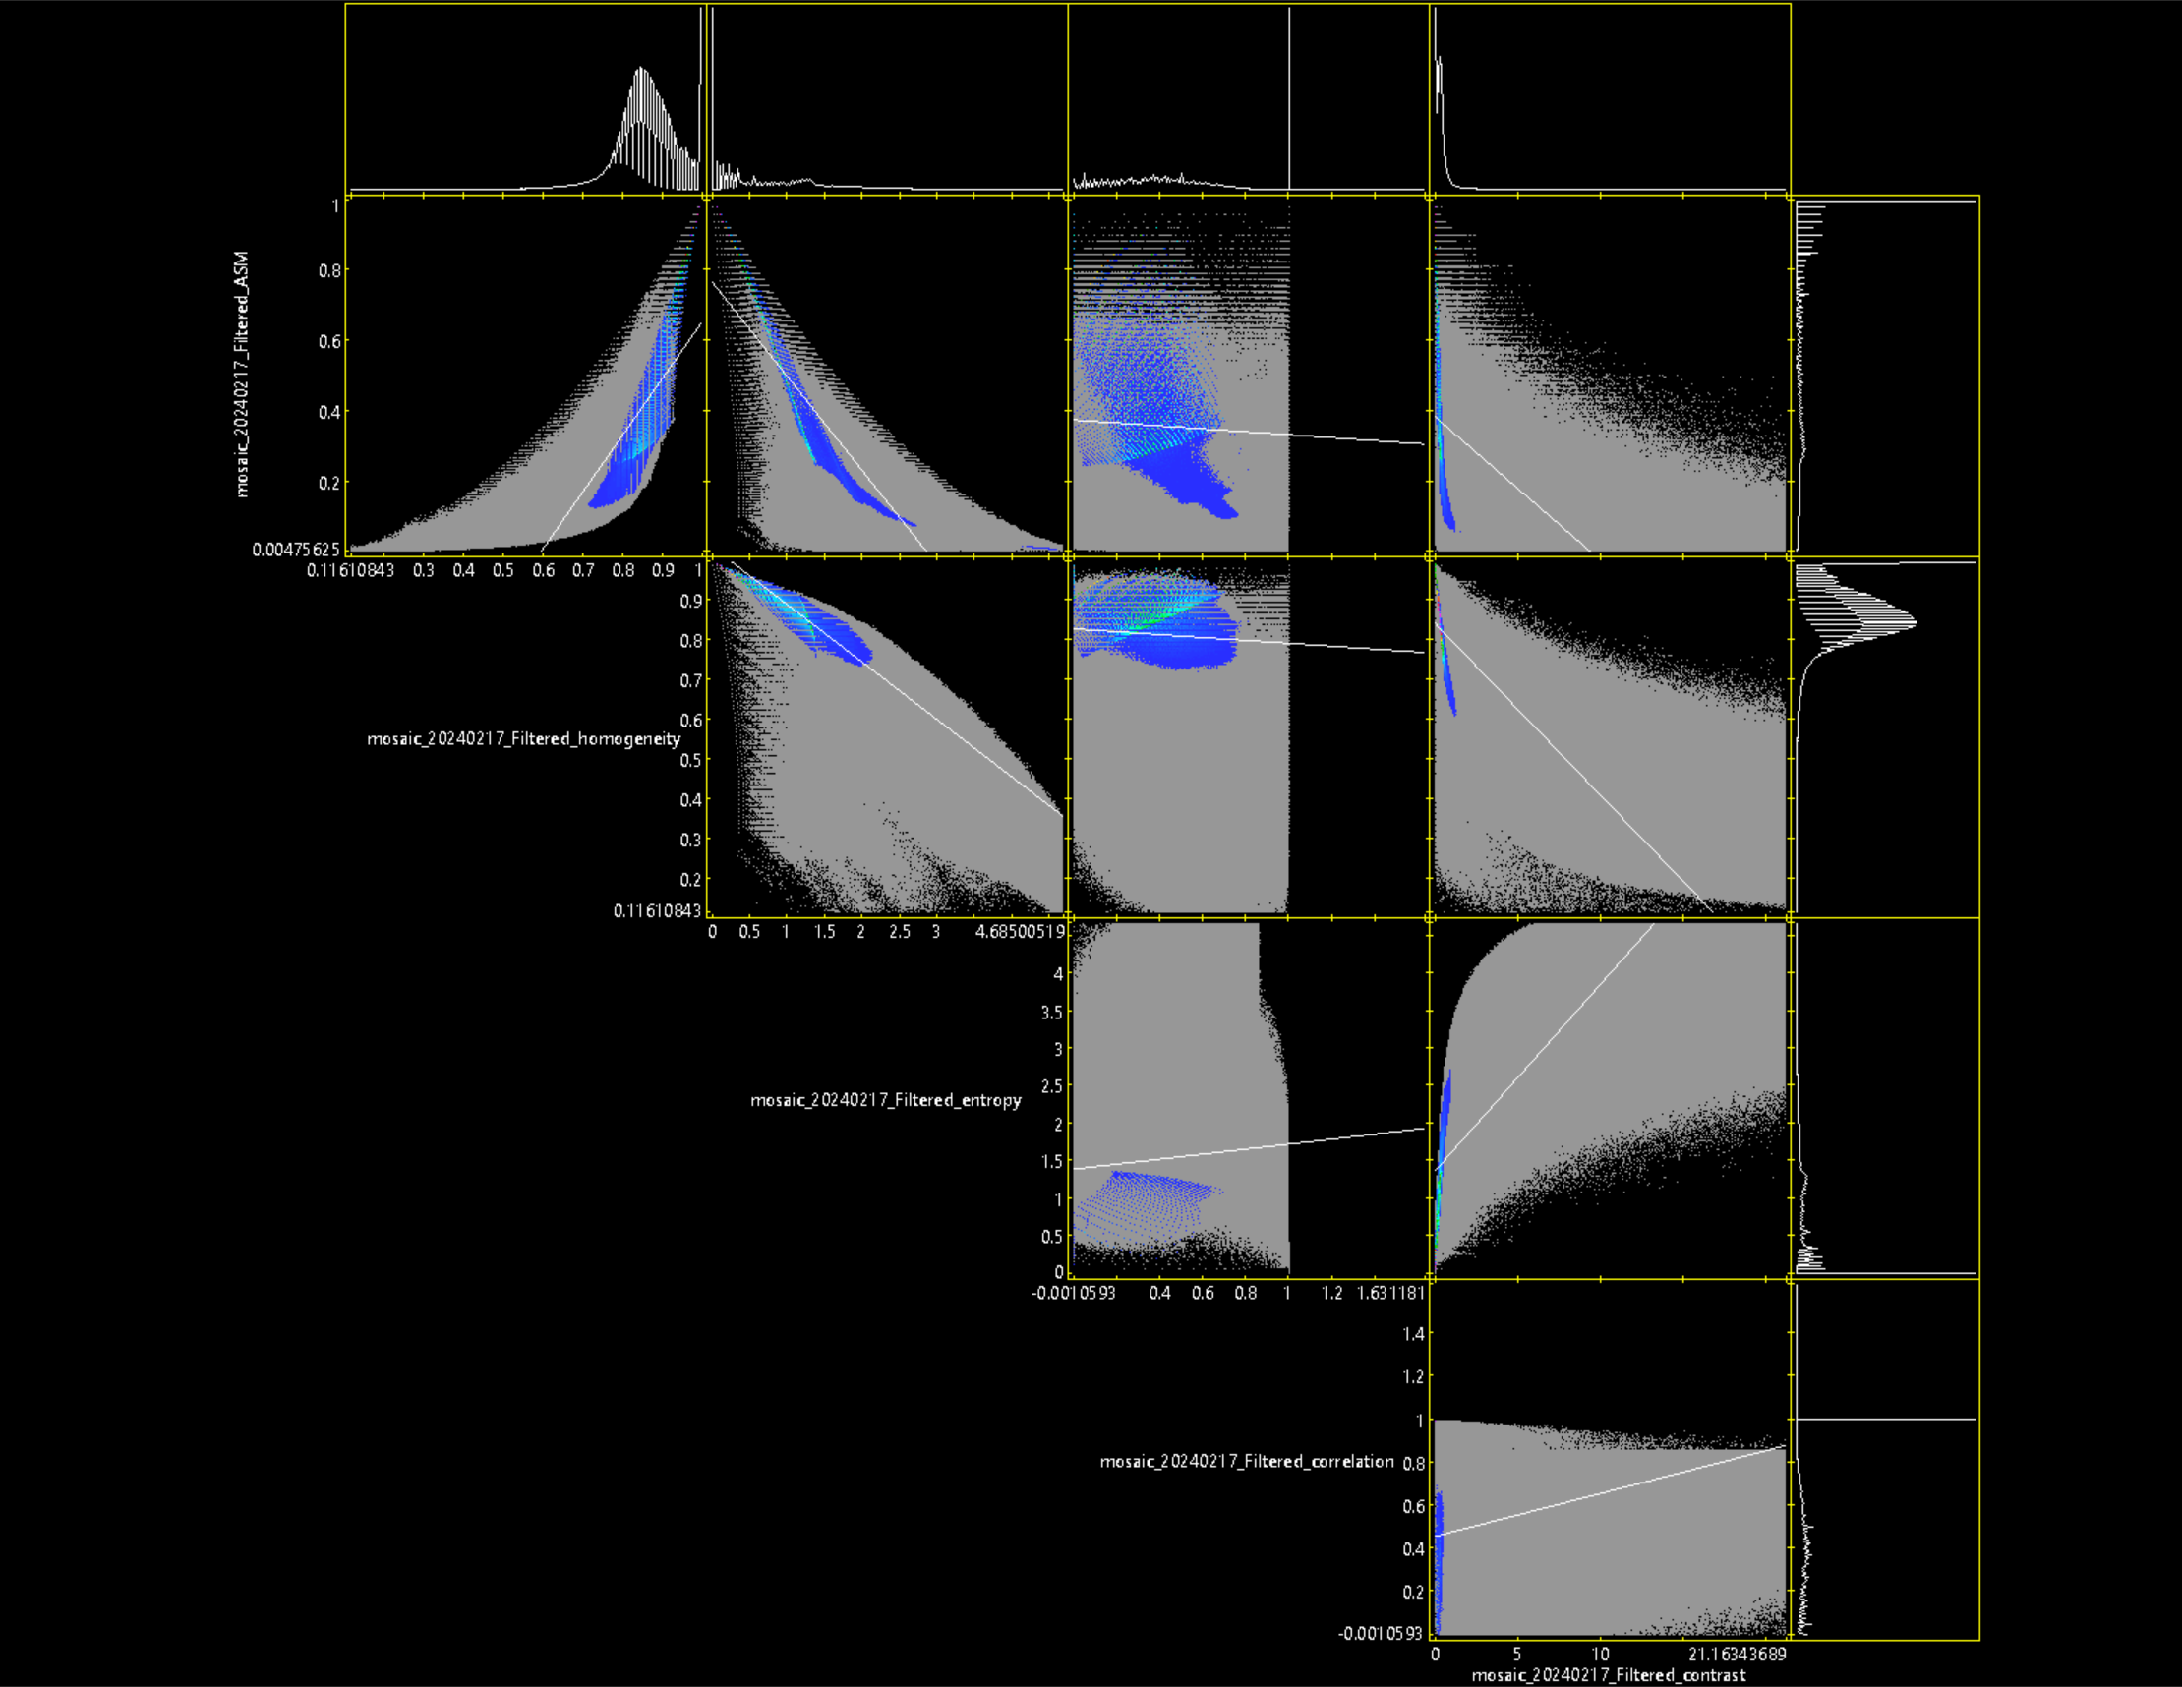
5X5
HOM
ENT
COR
CON
Correlation: 0.8020063
Y = 1.60488*X - 0.94841
Correlation: -0.8898518
Y = -0.26693*X + 0.76661
Correlation: -0.0667802
Y = -0.04237*X + 0.37554
Correlation: -0.3144926
Y = -0.04081*X + 0.38377
ASM
Correlation: -0.6693891
Y = -0.04341*X + 0.84248
HOM
Correlation: -0.1158305
Y = -0.03672*X + 0.8298
Correlation: -0.965683
Y = -0.14476*X +1.03543
Correlation: 0.1578140
Y = 0.33376*X + 0.138281
ENT
Correlation: 0.5770647
Y = 0.24965*X + 1.36749
COR
Correlation: 0.0979434
Y = 0.02004*X + 0.45614

Slide 2
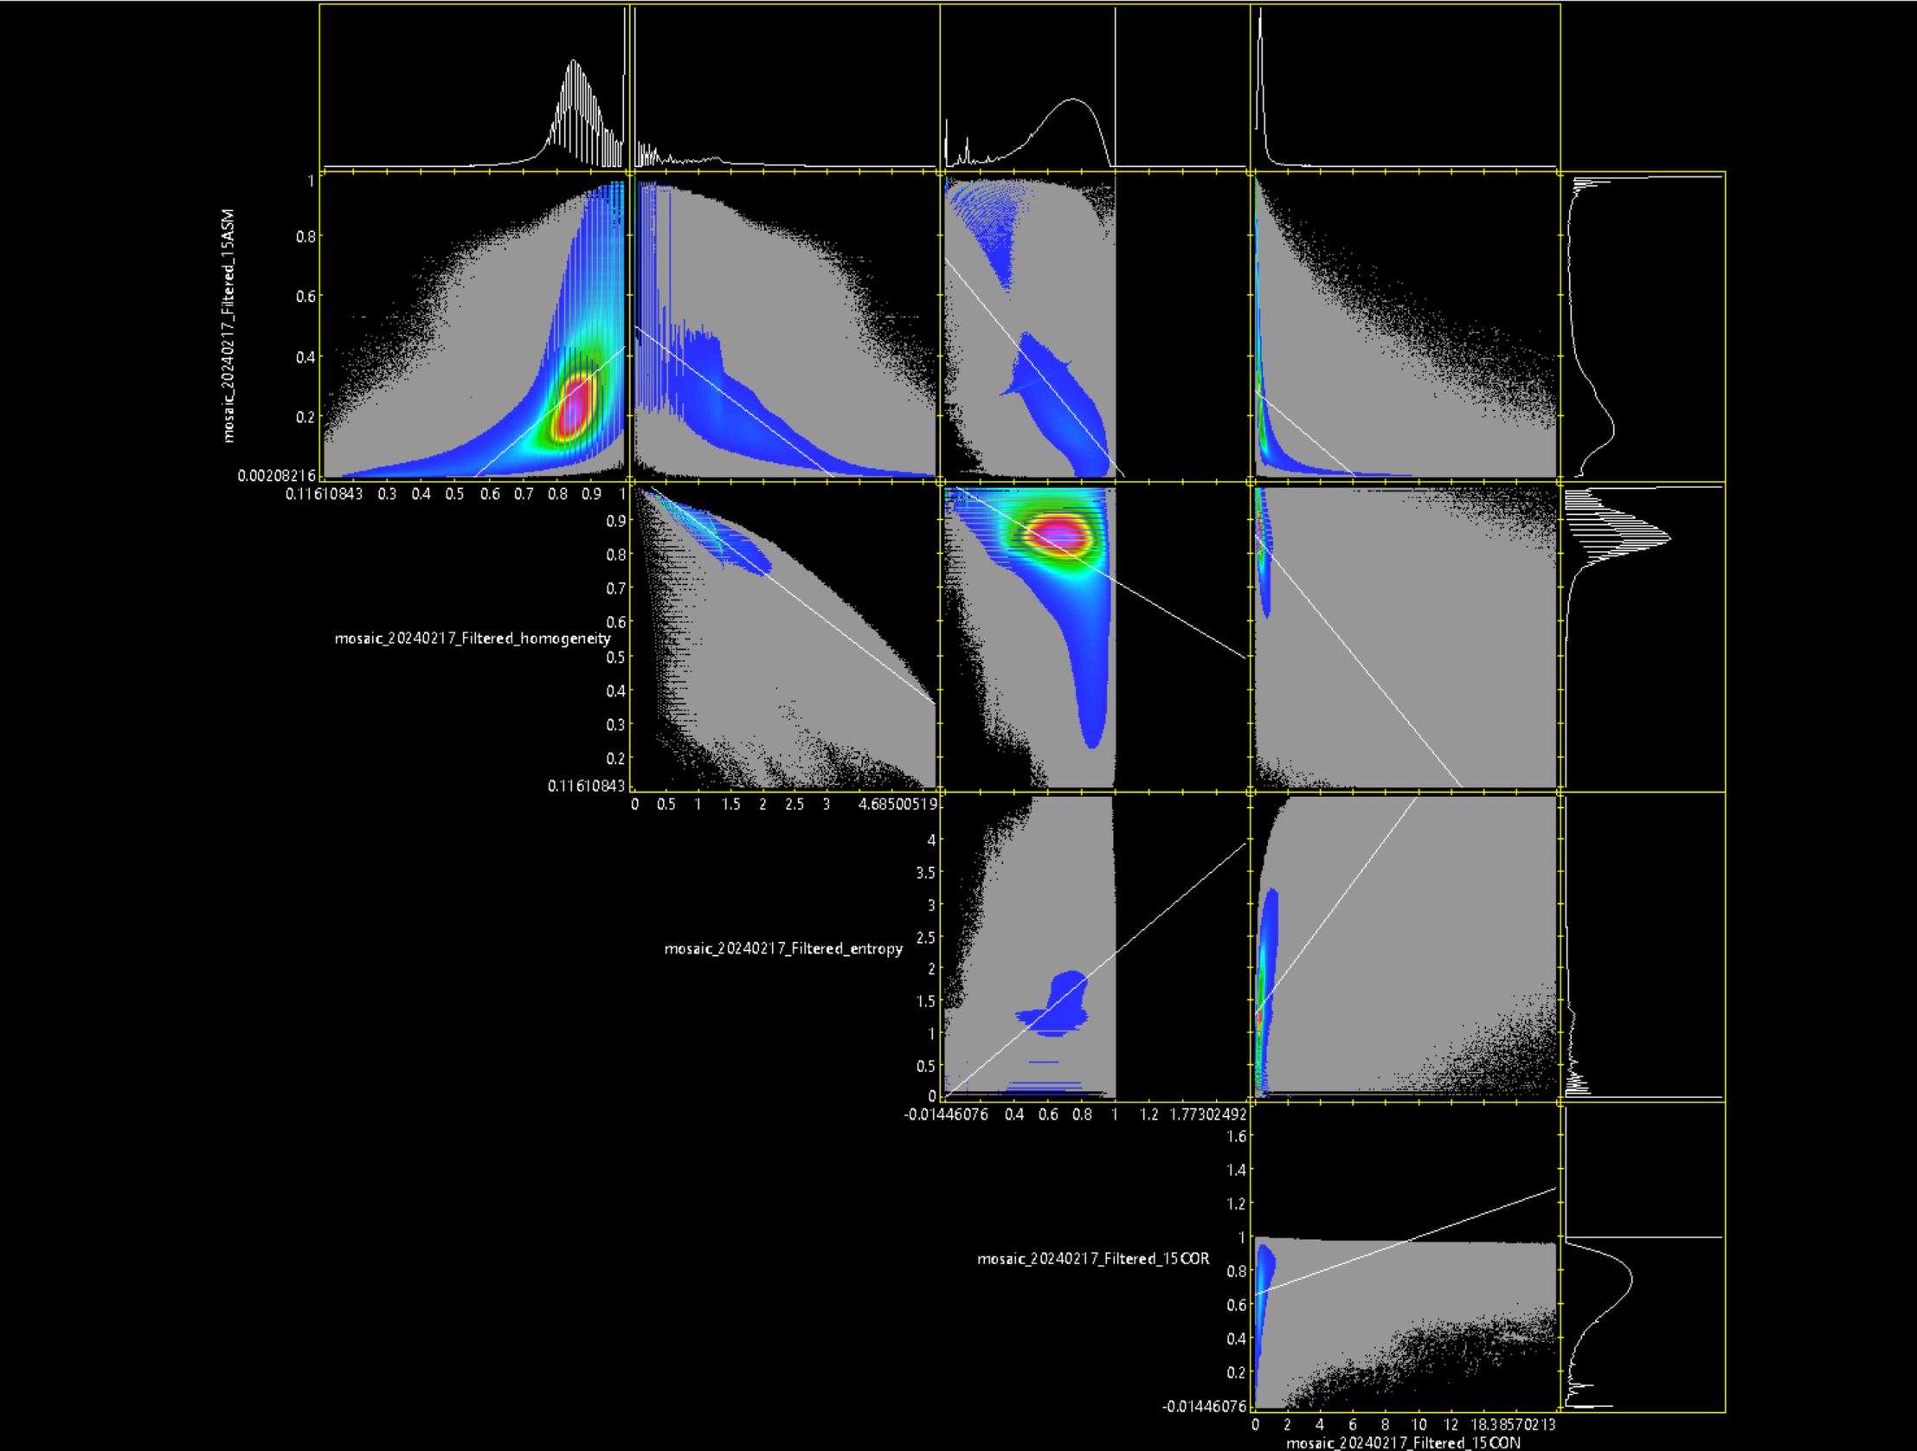
15X15
HOM
ENT
COR
CON
Correlation: 0.6565196
Y = 0.97588*X - 0.54107
Correlation: -0.7277311
Y = -0.16216*X + 0.50154
Correlation: -0.6523652
Y = -0.67875*X + 0.71264
Correlation: -0.3539125
Y = -0.04616*X + 0.28371
ASM
Correlation: -0.6671424
Y = -0.05854*X + 0.85292
HOM
Correlation: -0.4196705
Y = -0.29375*X + 1.01196
Correlation: -0.9656830
Y = -0.14476*X +1.03543
Correlation: 0.4760599
Y = 2.22285*X + 0.03068
ENT
Correlation: 0.5857318
Y = 0.34288*X + 1.30322
COR
討論後選用15X15 HOM和COR紋理特徵
Correlation: 0.2741583
Y = 0.03437*X + 0.65515

